Slide 1
API Gateway
JananI

Slide 2
Agenda
Monolithic Architecture
Microservices Architecture
Challenges & Limitations
Solution – API Gateway
Netflix Zuul
Demo

Slide 3
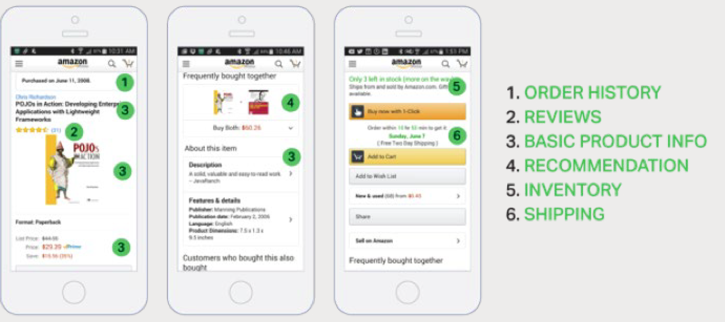
Scenario
Core services grow very quickly as well as whole system complexity
Hundreds of services involved in rendering of one complex webpage Ex: Amazon

Slide 4
Monolithic Architecture
A mobile client retrieves this data by making a single REST call to the application, such as:
GET api.company.com/productdetails/productId
A load balancer routes the request to one of several identical application instances.
The application then queries various database tables and return the response to the client

Slide 5
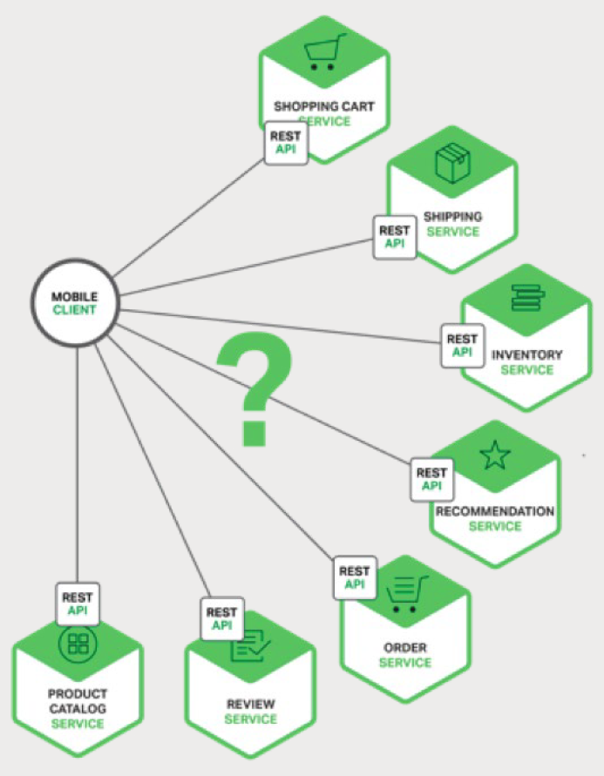
Microservices Architecture
Data displayed on the product details page is owned by multiple microservices
Shopping Cart Service – Number of items in the shopping cart
Order Service – Order history
Catalog Service – Basic product information
such as product name, image, and price
Review Service – Customer reviews
Inventory Service – Low inventory warning
Shipping Service – Shipping options, deadlines, and costs, drawn separately from the shipping provider’s API
Recommendation Service(s) – Suggested items

Slide 6
Direct Client-to-Microservice Communication
Client could make requests to each of the microservices directly
Each microservice would have a public endpoint:
https://serviceName.api.company.name
This URL would map to the microservice’s load balancer, which distributes requests across the available instances.
To retrieve the product-specific page information, the mobile client would make requests to each of the services listed in the previous slide

Slide 7

Challenges & Limitations
Necessity to know all endpoints addresses
The client in this example has to make seven separate requests
Makes the client code much more complex
Perform http request for each piece of information separately
Merge the result on a client side
Difficult to refactor the microservices
Non web-friendly protocols

Slide 8
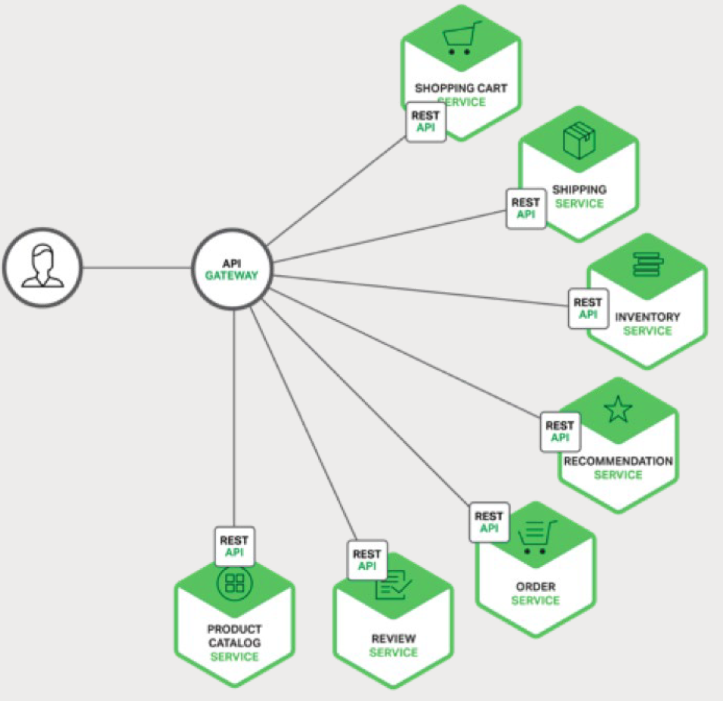
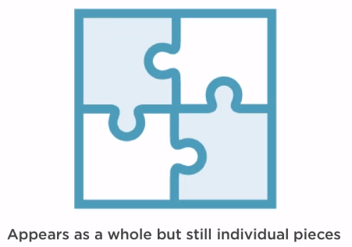
Solution – API Gateway

Slide 9
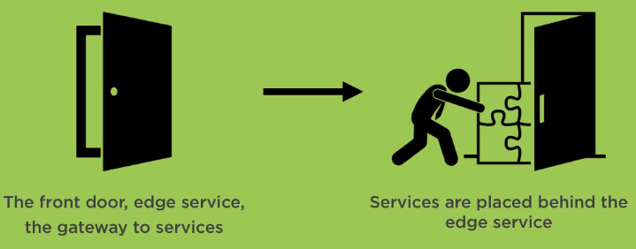
API Gateway
A single entry point into the system
Handle requests
by routing them to the appropriate backend service or
by invoking multiple backend services
Aggregating the results

Slide 10
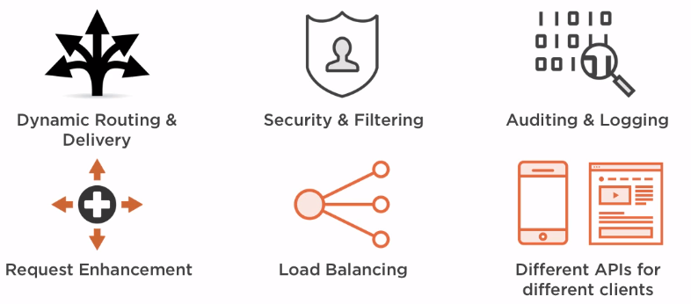
API Gateway – Usage

Slide 11
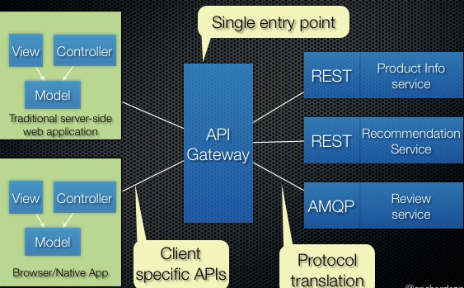
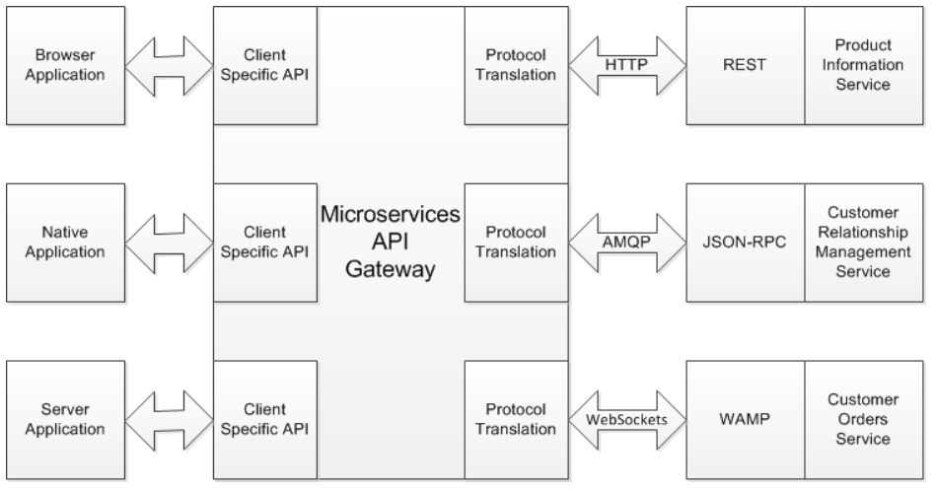
API Gateway - Usage
Request routing
Composition
Protocol translation

Slide 12
Netflix Zuul Project
Zuul is a gateway service that provides dynamic routing, monitoring, resiliency, security and more.
Zuul = Spring Cloud + Netflix

Slide 13
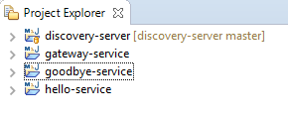

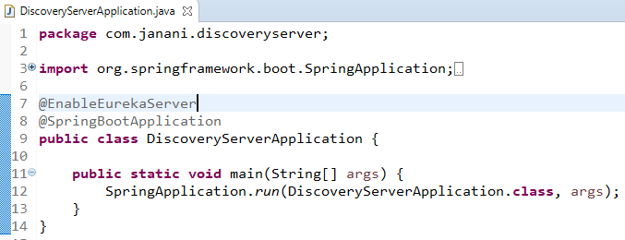
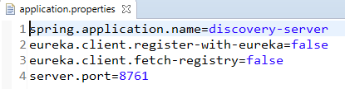
Demo - DiscoveryServer

Slide 14
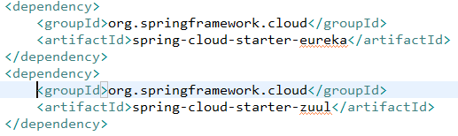

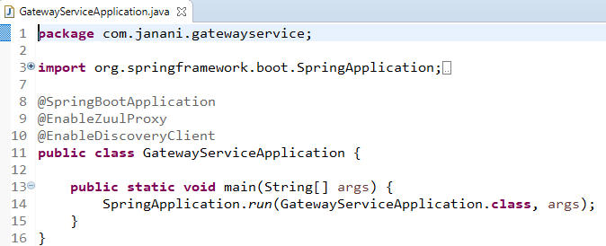
Demo - GatewayService

Slide 15
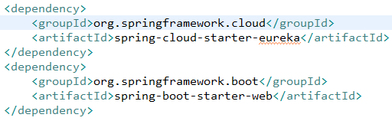
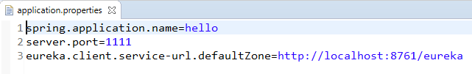
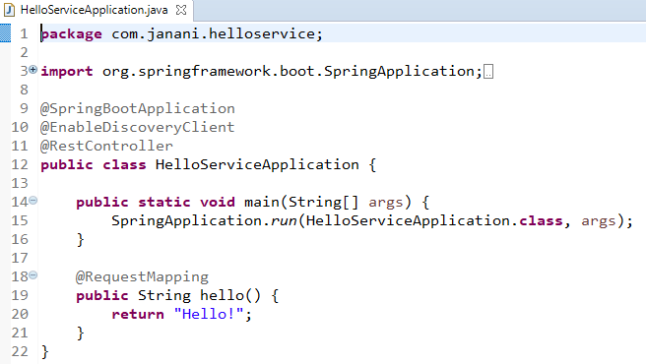
Demo – Hello/Goodbye Service
NOTE: To create GoodbyeService,
Replace hello with goobye
and server.port=2222

Slide 16
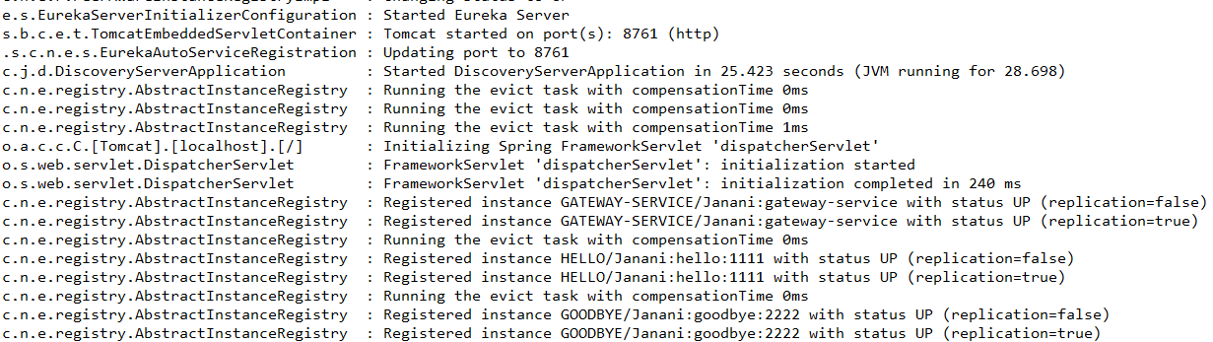
Service Status

Slide 17
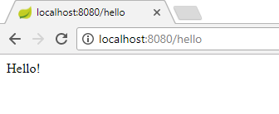
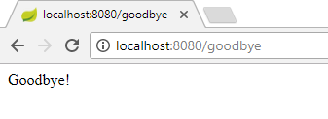
Outcome

Slide 18
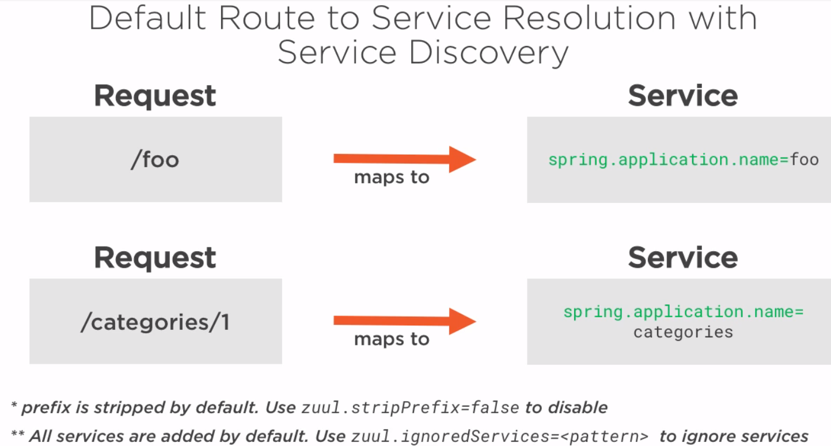
Properties

Slide 19
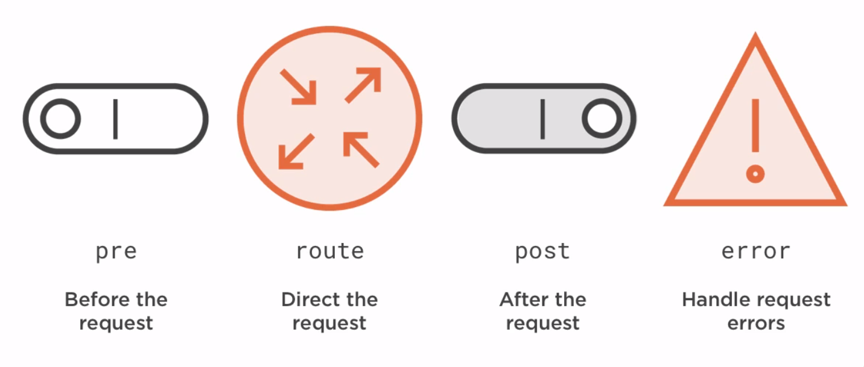
Zuul Filters - Types

Slide 20
Thank You
https://github.com/JananiVelmurugan
discovery-server
gateway-service
hello-service
goodbye-service

